Slide 1
TIME SERIES REGRESSION

Slide 2
Contents
Linear Regression Model for Time Series Data
The Concept of Autocorrelation
Autocorrelation in Multiple Linear Regression
Detecting Presence of Autocorrelation
Durbin Watson Test
Durbin Watson Test in R
Remedial Measure: Maximum Likelihood Estimation Method

Slide 3
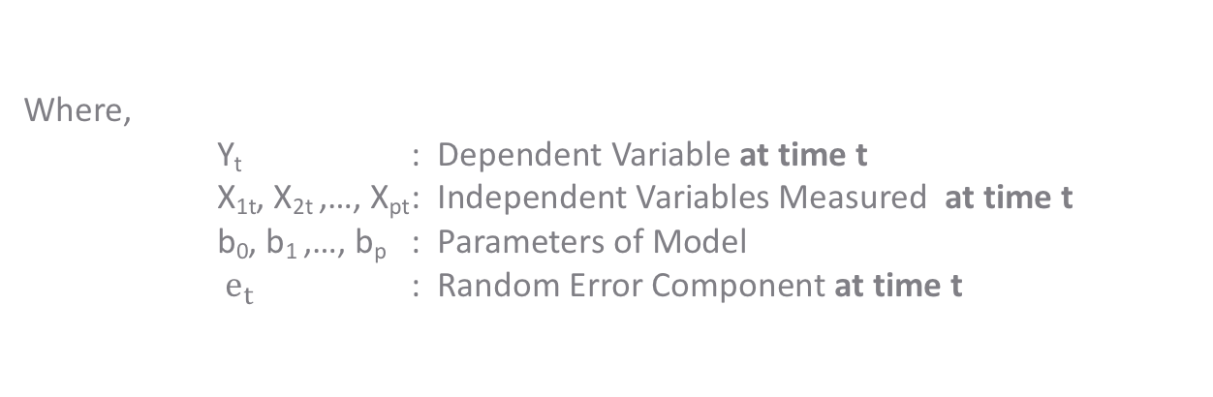
Linear Regression Model for Time Series Data
$$Y_{t}= b_{0}+b_{1}X_{1t}+b_{2}X_{2t}+ … +b_{p}X_{pt}+ e_{t}$$
Where,
Y_{t} : Dependent Variable at time t
X_{1t}, X_{2t} ,…, X_{pt} : Independent Variables Measured at time t
b₀, b₁ ,…, b_{p} : Parameters of Model
$e_{t}$ : Random Error Component at time t
Variables can either be Continuous or Categorical

Slide 4
The Concept of Autocorrelation
Autocorrelation is a correlation between a time series (Y_{t} ) and another time series representing lagged values of the same time series(Y_{t-k}).
Autocorrelation refers to the correlation of a time series with its own past values
Correlation between Y_{t} and Y_{t-1} is "first order autocorrelation"
t | Y_{t}
1 | Y₁
2 | Y₂
” | ”
” | ”
10 | Y₁₀
t | Y_{t} | Y_{t-1}
2 | Y₂ | Y₁
3 | Y₃ | Y₂
” | ” | ”
” | ” | ”
10 | Y₁₀ | Y₉

Slide 5
Autocorrelation in Multiple Linear Regression
Autocorrelation is observed only when the data is a time series or panel data
In regression model, absence of autocorrelation among errors is one of the key assumptions
Incorrect Standard Errors of Parameters
Autocorrelation
If we obtain the OLS estimators of the regression model without correcting error autocorrelation, the model may yield
Underestimation of True Error Variance
Overestimation of R²
Misleading Results of t & F Tests

Slide 6
Case Study – Predicting Sales
Background
Objective
Available Information
A retail store undertakes two-fold marketing campaign, one for print media and the other for digital. The company also collects information on yearly increments (price adjusted) in sales. The company wishes to check if the marketing expenses have any bearing on the sales
To predict price adjusted incremental sales based on expenses on marketing campaigns
Independent Variables: Marketing expenses for – Print Media and Online
Yearly time series data, of 11 years
Dependent Variable: Price Adjusted Incremental Sales

Slide 7
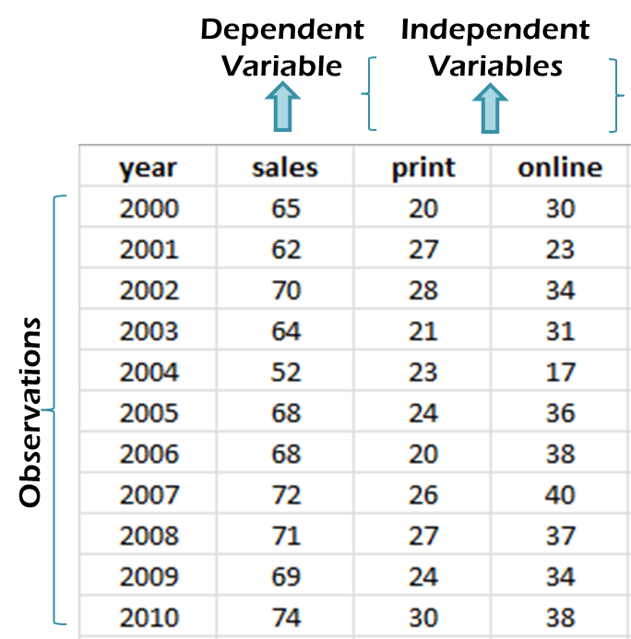
Data Snapshot
SALES VS MARKETING COSTS
Columns0 | Description | Type | Measurement | Possible values
Year | Year | Numeric | 2000 to 2010 | 11
Sales | Price Adjusted Incremental Sales | Numeric | in INR Million | Positive values
Print | Expenses on Print Marketing | Numeric | in INR Million | Positive values
online | Expenses on Online Marketing | Numeric | in INR Million | Positive values

Slide 8
Detecting Presence of Autocorrelation – Durbin Watson Test
Objective | To check the assumption of 'No Autocorrelation‘
Null Hypothesis H₀: Autocorrelation is not present among errors
Alternate Hypothesis H₁: Not H0
Test Statistic | d ≅ 2 (1- r) Where r is sample autocorrelation based on residuals obtained in regression model. Ideal Value of d = 2 (taking r = 0)
Decision Criteria | Reject the null hypothesis if p-value < 0.05

Slide 9
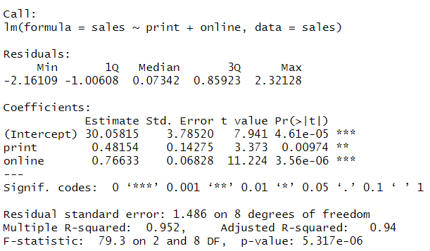
Durbin Watson Test in R
# Importing the Data and Fitting Linear Model
sales<-read.csv("SALES VS MARKETING COSTS.csv",header=TRUE) salesmodel<-lm(sales~print+online,data=sales) summary(salesmodel)
# Output

Slide 10

Durbin Watson Test in R
# Install & Load package “car”
# Durbin Watson Test
install.packages("car") library(car) durbinWatsonTest(salesmodel)
durbinWatsonTest() in package car carries out the Durbin Watson test. Output gives the d-w statistic as well as p-value.
# Output
Interpretation :
Reject H0, p-value<0.05.
Errors have significant autocorrelation.

Slide 11
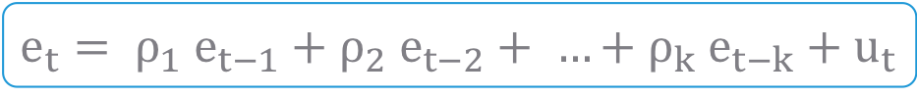

Error Process in the Presence of Autocorrelation
Presence of autocorrelation implies that, errors at time t are related to errors at previous time points
$ρ_{k}$ is coefficient of autocorrelation of lag k between $e_{t}$ & $e_{t −k}$
$u_{t}$ is such that,
E($u_{t}$)=0
V($u_{t}$)= Constant
Cov($u_{t}$ , $u_{s}$)=0 s≠0
$e_{t}= ρ_{1}$ $e_{t−1}+ρ_{2} e_{t−2}+ …+ρ_{k} e_{t−k}+u_{t}$
*
Note: Typically in time series regression we consider autocorrelation of order 1 only

Slide 12
Consequences of Ignoring Autocorrelation
If we obtain the OLS estimators of the model, without correcting error autocorrelation, the model may yield
Underestimation of True Error Variance
Overestimation of R²
Misleading Results of t & F Tests

Slide 13
Autocorrelation – Remedial Measures
The following three methods can be used to estimate regression parameters when there exists autocorrelation in the time series data. We will focus on MLE method.
Cochrane-Orcutt Method
Praise-Winsten Method
Maximum Likelihood Estimation Method

Slide 14
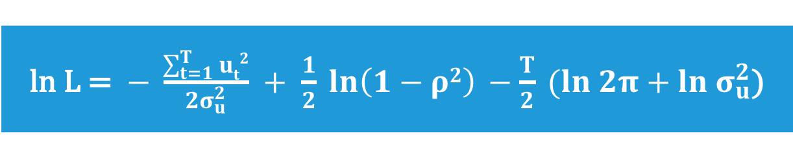
Maximum Likelihood Estimation Method
Maximum likelihood estimator (MLE) can be obtained by maximizing the log likelihood function with respect to b, σ²_{u}, ρ
Log likelihood function is given as follows:
ln L = $− \frac{\sum_{t=1}^{T}{ut2}}{2σ_{u}^{2}} + \frac{1}{2} ln\left(1−ρ2\right) −\frac{T}{2} (ln 2π+ln σ_{u}^{2}\text{)}$

Slide 15
Parameter Estimation – Maximum Likelihood Estimation Method
# Parameter Estimation (Maximum Likelihood Estimation)
salests<-ts(sales$sales,start=2000,end=2010) xvar<-subset(sales,select=c("online","print")) salesmodel<-arima(salests,order=c(1,0,0),xreg=xvar) coef(salesmodel) ar1 intercept online print 0.7774653 32.0288203 0.8117825 0.3621399
ts() converts a column from a data frame to a simple time series object.
subset() creates a subset of all the independent variables
arima() estimates model parameters. Subset of independent variables (which is a vector or matrix of external regressors) is used in xreg=

Slide 16
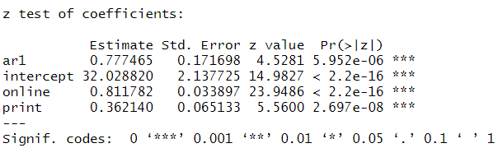
Parameter Estimation – Maximum Likelihood Estimation Method
#Parameter Estimation (Maximum Likelihood Estimation)
install.packages("lmtest") library(lmtest) coeftest(salesmodel)
arima() does not give p-values, hence coeftest() from package lmtest() is used. It performs z and (quasi-)t tests of estimated coefficients.
# Output
Interpretation :
Both print and online are significant variables in this output as well

Slide 17
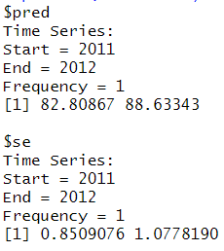
Predictions
# Predictions (For Next Two Years)
online<-c(40,45) print<-c(50,55) xvarnew<-data.frame(online,print) predict(salesmodel, n.ahead=2, newxreg=xvarnew)
Expected Values of online and print marketing expenses in next 2 years.
data.frame() combines the future expenses into a single dataframe object, to be used for predictions.
predict() uses the MLE regression model, n.ahead=2 ensures next two forecasts are generated, newxreg= specifies the new values of independent variables.
# Output

Slide 18
Quick Recap
Statistical Model
Y_{t}=b₀ + b₁x_{1t} + b₂x_{2t} + - - - - + b_{p}x_{pt} + e_{t}
Here, t – the time element is added to each term
What is Autocorrelation
Autocorrelation refers to the correlation of a time series with its own past values
Consequences
Presence of Autocorrelation results in incorrect standard errors of model parameters
Test
The Durbin Watson test is used to check autocorrelation
durbinwatsonTest() in package car performs the D-W Test in R
Maximum Likelihood Estimation Method
Method of correcting autocorrelation problem

Slide 19
THANK YOU!!

